Slide 1
A Look at the U.S. Housing Affordability
Using Zillow Group’s Data (1979-03 to 2018-06)
by Zexi Ye

Slide 2
Outline
Geography
Historical Trend
Correlation
Which metropolitan areas are the most expensive by
Price-to-Income Ratio
Mortgage Affordability
Renter Affordability
How has housing affordability changed over time?
Largest increase
Trajectories
House Price Boom & Crisis of 2008
Are the 3 housing affordability indices correlated?

Slide 3
Geography
Which Metropolitan Areas Are the Most Expensive to Live?
Lollipops & Maps

Slide 4
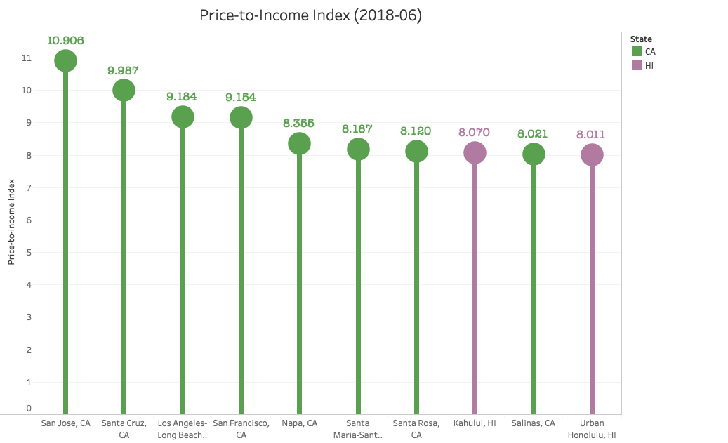
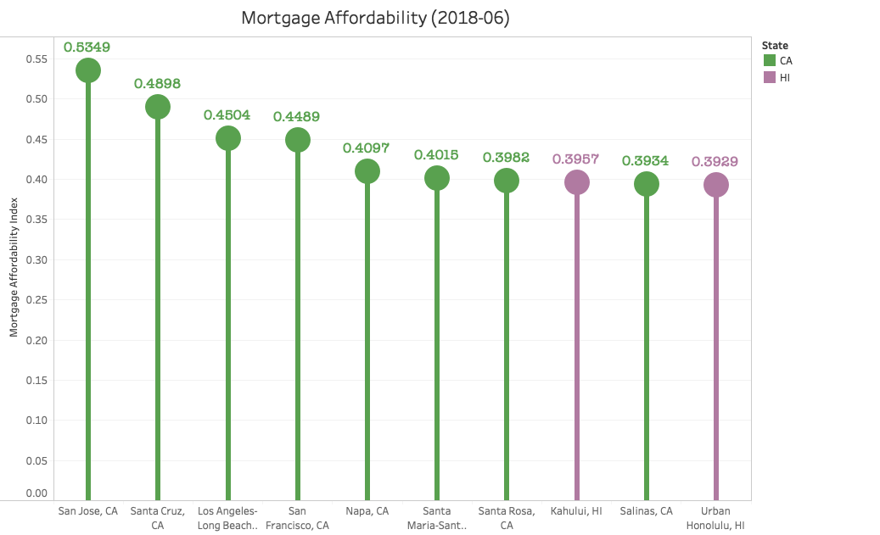
Geography
The metropolitan areas are ranked by Price-to-Income Ratio, Mortgage Affordability and Renter Affordability using June 2018 data
Observe that, by Price-to-Income Ratio and Mortgage Affordability, cities in California take the lead in the Top 10 (8 out of 10), with 2 Hawaiian cities following
All cities are located in the West

Slide 5
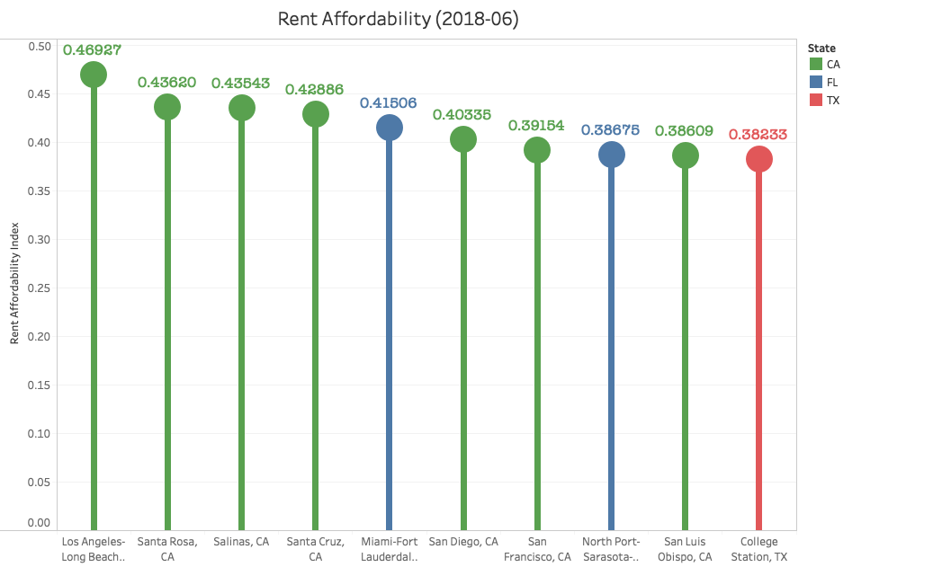
Geography
Ranked by Rent Affordability, the Top 10 cities see slightly more diversity in term of geography, yet Californian cities still have a heavy presence

Slide 6
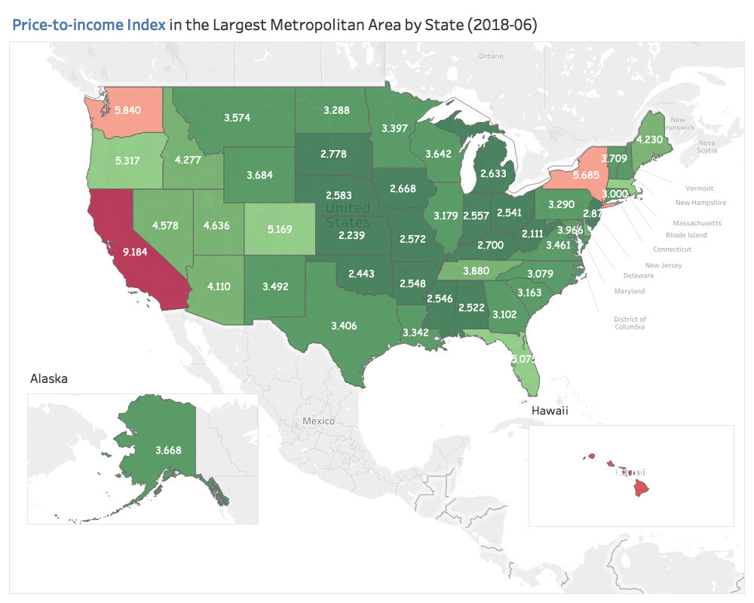
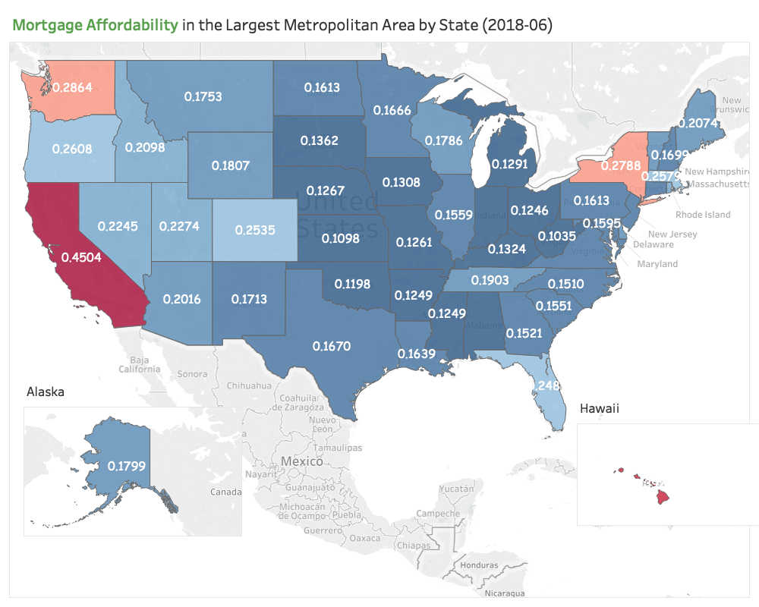
Geography
For each state, project the affordability indices of the most populous metropolitan areas onto maps
In terms of Price-to-Income Ratio and Mortgage Affordability, CA, WA, NY and HI are significantly more expensive to live in than the rest of the country

Slide 7
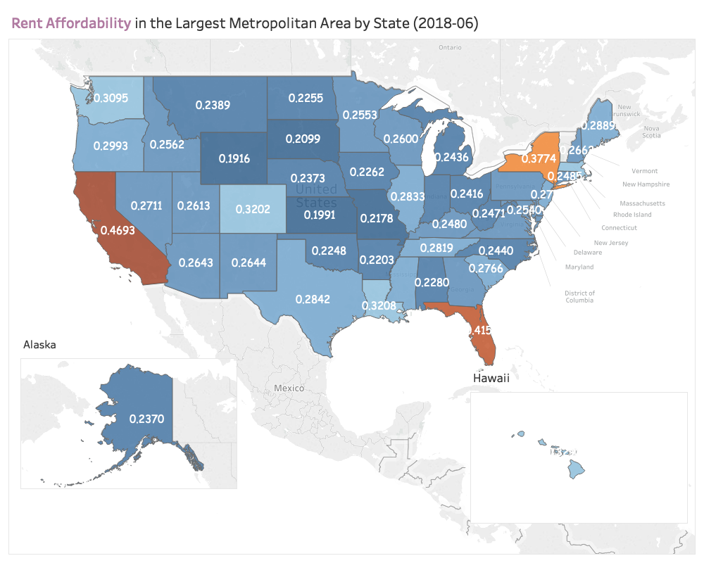
Geography
By Rent Affordability, in contrast, CA, NY and FL beat other states by a large margin
Housing in Central U.S. is generally more affordable in comparison to coastal states

Slide 8
Historical Trend
How Has Housing Affordability Changed over Time?
Tree Maps & Interactive Time Series

Slide 9
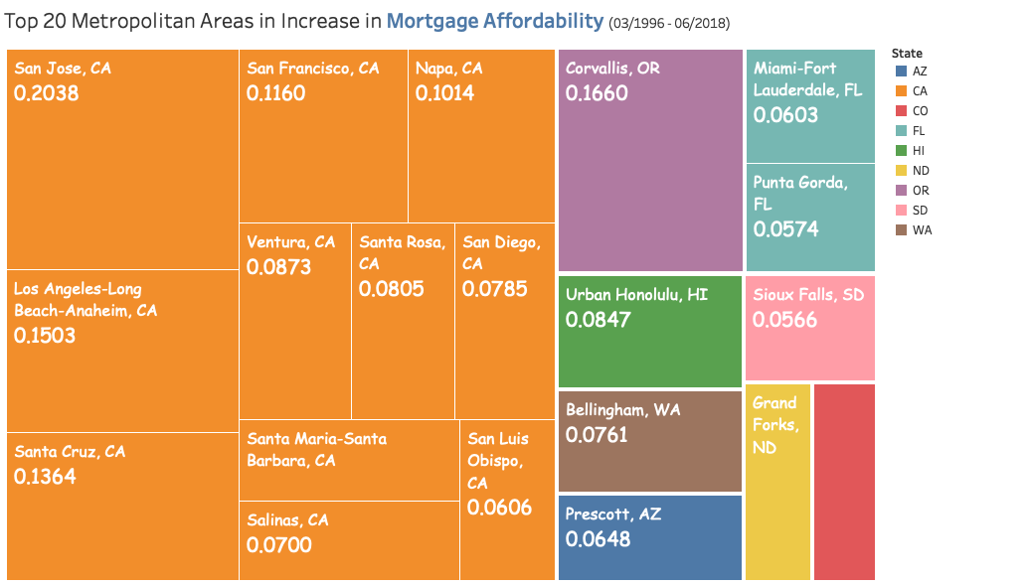
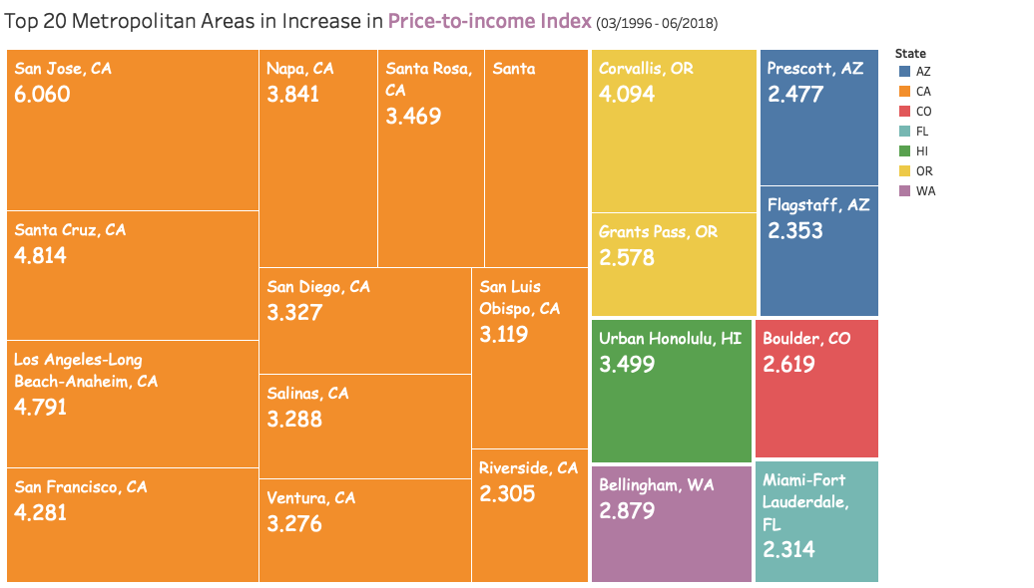
Again, by Geography
The tree maps exhibit the Top 20 metropolitan areas that experienced the highest growth in the 3 affordability indices from 03/1996 to 06/2018 (since 03/1996 there has been a relatively complete record of data)
Similar to the previous section, California again dominates, suggesting that in general the state has seen a universal and large increase in real housing price (accounted for the growth in income)
The Wild Wild West - western states take up 80-90% of the list

Slide 10
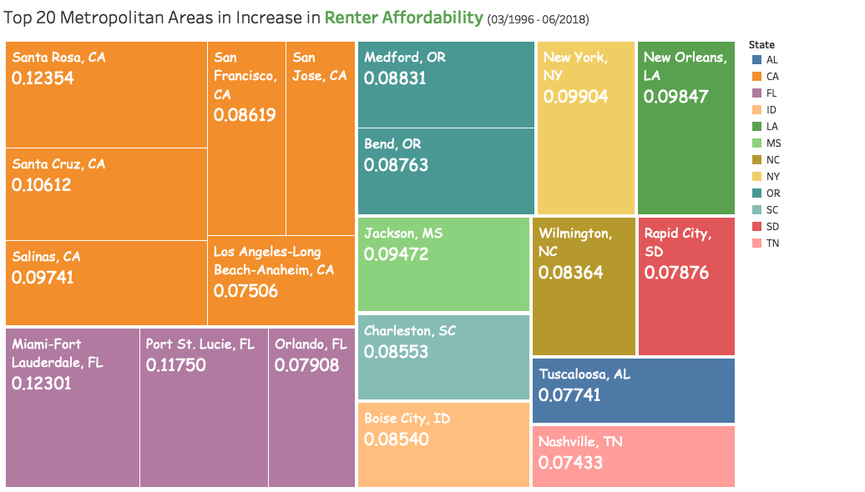
Again, by Geography
In terms of Renter Affordability, on the contrary, there is substantially more geographic diversity

Slide 11
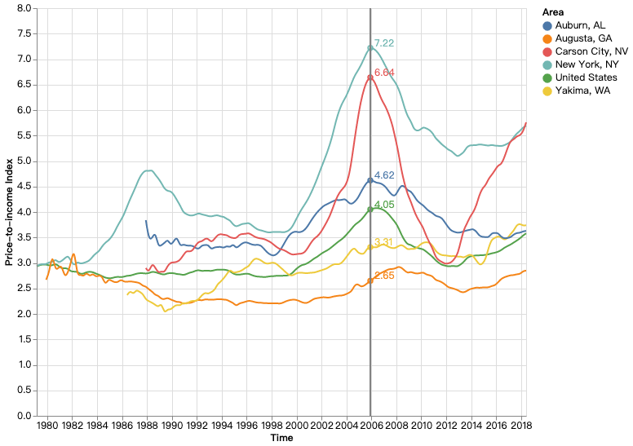
Change Over Time
Price-to-Income Ratio from 1979-03 to 2018-06
NOTE: These 3 graphs are interactive time series plots. You may open it in the Jupyter Notebook to interact with the plots by moving around your cursor
5 metropolitan areas & the national-level data are selected for plotting based on their rankings in population. Specifically,
Max - New York, NY
25% - Augusta, GA
Median - Yakima, WA
75% - Auburn, AL
Min - Carson City, NV

Slide 12
Price-to-Income Ratio
Price-to-Income Ratio from 1979-03 to 2018-06
1979 - 2000: Relatively stable level of Price-to-Income Ratio (with the exception of New York City)
2000 - 2007: Phenomenal increase in Price-to-Income Ratio across the U.S.
2007 - 2013: Collapse in Housing Price
2013 - 2018: Recovery from the Recession (with Carson City’s Price-to-Income Ratio soaring)

Slide 13
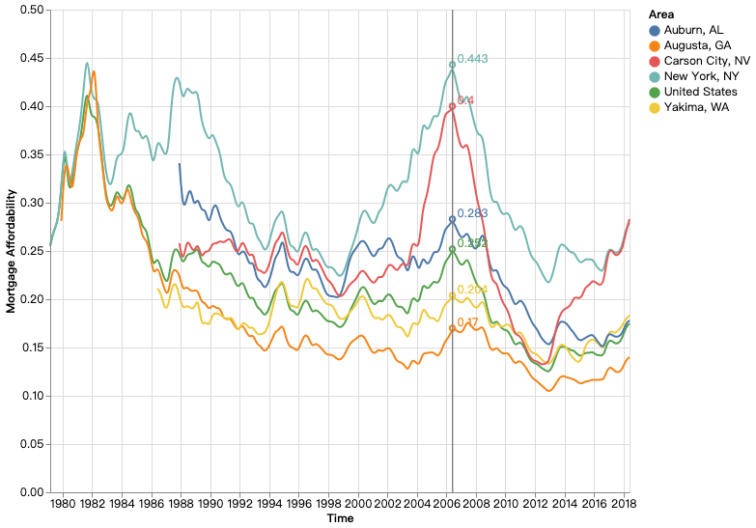
Mortgage Affordability
Mortgage Affordability from 1979-03 to 2018-06
Mortgage affordability is characterized by constant fluctuation
A general trend exists, but short-term up-and-downs are prevalent
The plot behaves similarly to the Price-to-Income Ratio plot, with the mortgage affordability index reaching its peak in 2006-2007 across the country and plummeted

Slide 14
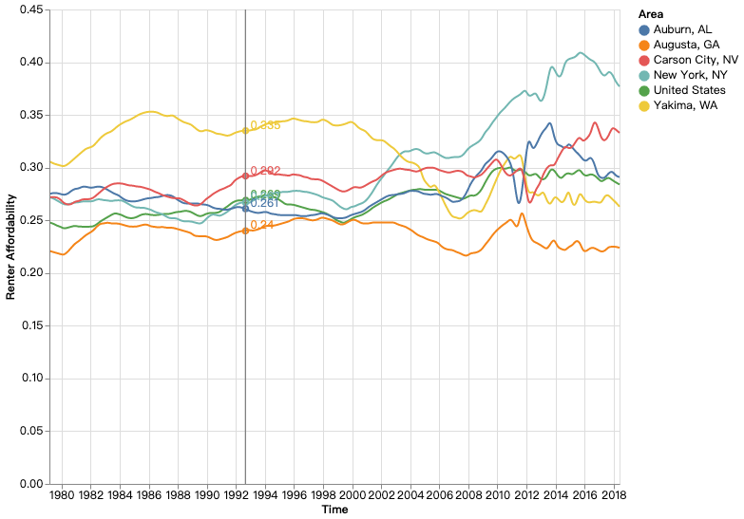
Renter Affordability
Renter Affordability from 1979-03 to 2018-06
Renter Affordability is marked by stability and low variance across cities over the years 1979-2008
Did not experience the boom and bust over 2000-2013 as opposed to Price-to-Income Ratio and Mortgage Affordability
Nevertheless, after the Crisis of 2008, renter affordability turned more volatile and saw more variation among different metropolitan areas

Slide 15
Correlation
Are the 3 Housing Affordability Indices Correlated?
Heatmap

Slide 16
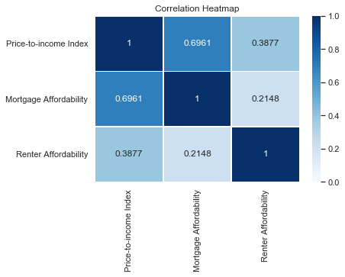
Correlation Heatmap
Previously noticed a pronounced consistency between Price-to-Income Ratio and Mortgage Affordability in graphs/plots
Created a correlation heatmap among the 3 indices using data from 1996-03 to 2018-06
Result
Price-to-Income Ratio and Mortgage Affordability have a correlation of 0.6961, which agrees with our observation
Correlations between other two pairs of indices are insignificant

Slide 17
Conclusion
max growth
From Visualizations to Insights

Slide 18
Conclusion
During the period from 2000 - 2007, the real U.S. housing prices and mortgage saw a universal boom, crashed, and gradually recovered. In contrast, rents enjoyed stability until 2008, where they became volatile
In general, the Price-to-Income Ratio and the Mortgage Affordability display highly consistent behaviors, while Renter Affordability behaves more independently
Western states (California, above all) are the least welcoming in terms of housing affordability if you seek to purchase a house
Also, western states experienced the greatest increase in real housing prices over the past 13 years
Interestingly, Florida has a notable presence in rents and increase in rents over time

